Slide 1
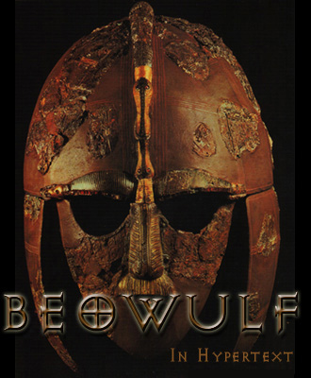

Slide 2
Beowulf
Poet unknown
Anglo-Saxon and Old English
Christian (but with a bit of pagan tradition)
Epic poem (with 3,182 lines)
Epic = a very long poem that tells the adventures of a hero
Epic Hero = a larger-than-life character who has great adventures, often boasts, and values personal appearance/identity

Slide 3
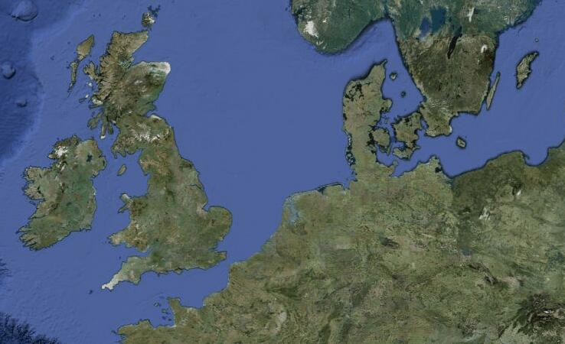
Anglo-Saxon Migration

Slide 4
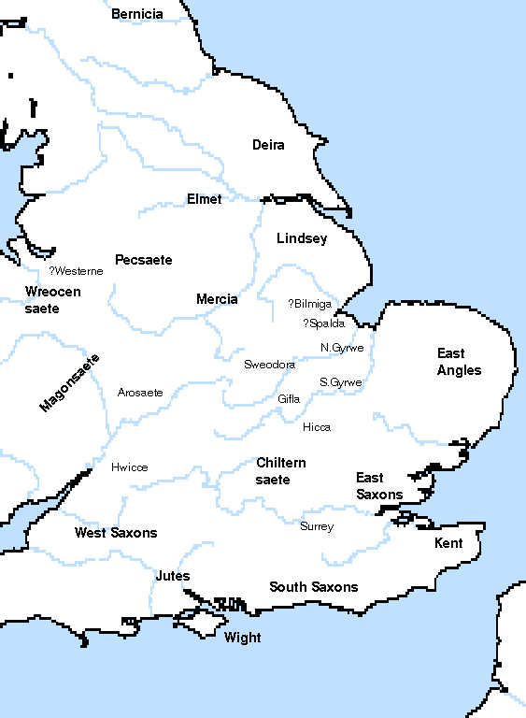

Slide 5
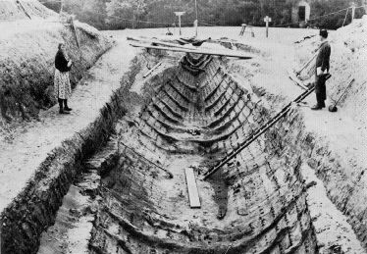
Sutton Hoo

Slide 6
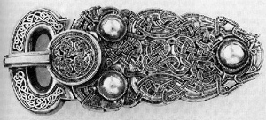
Anglo-Saxon Artifacts

Slide 7
Old English
Hwæt! We Gardena in geardagum, þeodcyninga, þrym gefrunon, hu ða æþelingas ellen fremedon. Oft Scyld Scefing sceaþena þreatum,
monegum mægþum, meodosetla ofteah, egsode eorlas. Syððan ærest wearð feasceaft funden, he þæs frofre gebad, weox under wolcnum, weorðmyndum þah, oðþæt him æghwylc þara ymbsittendra
ofer hronrade hyran scolde, gomban gyldan. þæt wæs god cyning! Ðæm eafera wæs æfter cenned, geong in geardum, þone god sende folce to frofre; fyrenðearfe ongeat
15 þe hie ær drugon aldorlease
lange hwile. Him þæs liffrea, wuldres wealdend, woroldare forgeaf; Beowulf wæs breme

Slide 8
Modern English
LO, praise of the prowess of people-kings of spear-armed Danes, in days long sped, we have heard, and what honor the athelings won! Oft Scyld the Scefing from squadroned foes, from many a tribe, the mead-bench tore, awing the earls. Since erst he lay friendless, a foundling, fate repaid him: for he waxed under welkin, in wealth he throve, till before him the folk, both far and near, who house by the whale-path, heard his mandate, gave him gifts: a good king he! To him an heir was afterward born, a son in his halls, whom heaven sent to favor the folk, feeling their woe that erst they had lacked an earl for leader so long a while; the Lord endowed him, the Wielder of Wonder, with world's renown. Famed was this Beowulf:

Slide 9
Comparison
Hwæt! We Gardena in geardagum,
þeodcyninga, þrym gefrunon,
hu ða æþelingas ellen fremedon.
LO, praise of the prowess of people-kings
of spear-armed Danes, in days long sped,
we have heard, and what honor the athelings won!
They’re Both English!

Slide 10
Old English
hus house
hwæt wheat
weall wall
wer man
wulf wolf
engel angel
bedd bed
blæc black

